Slide 1
Regression Analysis
Multiple Linear Regression
Nicoleta Serban, Ph.D.
Professor
School of Industrial and Systems Engineering
Basics of Multiple Regression

Slide 2

About This Lesson

Slide 3
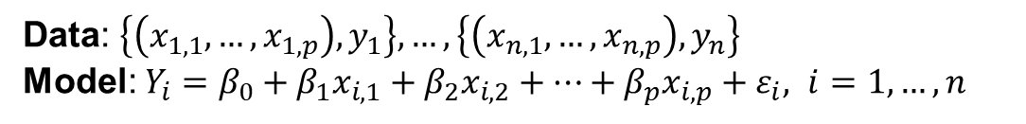
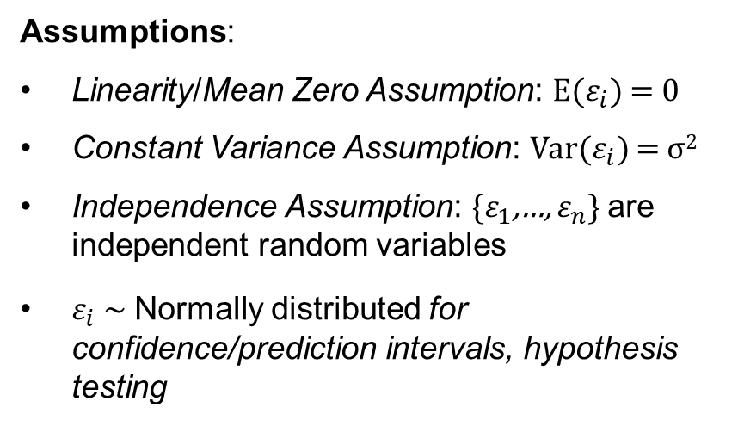
Multiple Linear Regression: Model
Data: $\left\{\left(x_{1,1},…,x_{1,p}\right),y_{1}\right\},…,\left\{\left(x_{n,1},…,x_{n,p}\right),y_{n}\right\}$
Model: $Y_{i}=β_{0}+β_{1}x_{i,1}+β_{2}x_{i,2}+…+β_{p}x_{i,p}+ε_{i}, i=1, …,n$
Assumptions:
Linearity/Mean Zero Assumption: E($ε_{i}$) = 0
Constant Variance Assumption: Var($ε_{i}$) = σ²
Independence Assumption: {$ε_{1}$,…, $ε_{n}$} are independent random variables
$ε_{i}$ ~ Normally distributed for confidence/prediction intervals, hypothesis testing

Slide 4
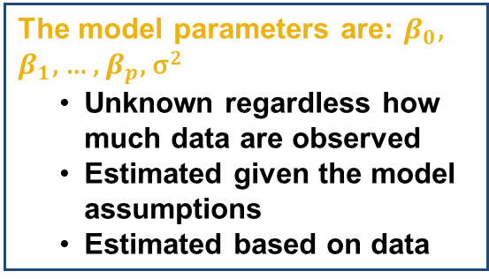
Multiple Linear Regression: Model
Data: $\left\{\left(x_{1,1},…,x_{1,p}\right),y_{1}\right\},…,\left\{\left(x_{n,1},…,x_{n,p}\right),y_{n}\right\}$
Model: $Y_{i}=β_{0}+β_{1}x_{i,1}+β_{2}x_{i,2}+…+β_{p}x_{i,p}+ε_{i}, i=1, …,n$
Assumptions:
Linearity/Mean Zero Assumption: E($ε_{i}$) = 0
Constant Variance Assumption: Var($ε_{i}$) = σ²
Independence Assumption: {$ε_{1}$,…, $ε_{n}$} are independent random variables
$ε_{i}$ ~ Normally distributed for confidence/prediction intervals, hypothesis testing
The model parameters are: $β_{0}$, $β_{1}$, … , $β_{p}$, σ²
  Unknown regardless how much data are observed
  Estimated given the model assumptions
  Estimated based on data

Slide 5
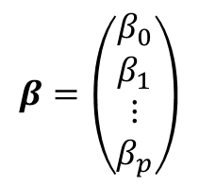

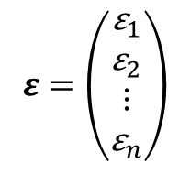
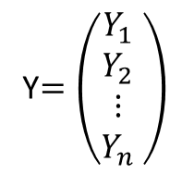
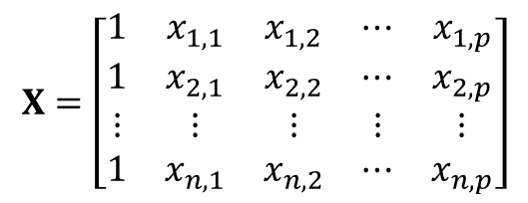
Multiple Linear Regression: Model
Data: $\left\{\left(x_{1,1},…,x_{1,p}\right),y_{1}\right\},…,\left\{\left(x_{n,1},…,x_{n,p}\right),y_{n}\right\}$
Model: $Y_{i}=β_{0}+β_{1}x_{i,1}+β_{2}x_{i,2}+…+β_{p}x_{i,p}+ε_{i}, i=1, …,n$
Model in Matrix Form: Y$=Xβ+ε$
Response
Design Matrix
Coefficients
Error
Y$=\left(\begin{matrix}Y_{1} \\ Y_{2} \\ ⋮ \\ Y_{n}\end{matrix} \right)$
$$X=\left[\begin{matrix}1 & x_{1,1} & x_{1,2} & ⋯ & x_{1,p} \\ 1 & x_{2,1} & x_{2,2} & ⋯ & x_{2,p} \\ ⋮ & ⋮ & ⋮ & ⋮ & ⋮ \\ 1 & x_{n,1} & x_{n,2} & ⋯ & x_{n,p}\end{matrix}\right]$$
$$β=\left(\begin{matrix}β_{0} \\ β_{1} \\ ⋮ \\ β_{p}\end{matrix}\right)$$
$$ε=\left(\begin{matrix}{\text{ε}}_{1} \\ {\text{ε}}_{2} \\ ⋮ \\ {\text{ε}}_{n}\end{matrix}\right)$$

Slide 6
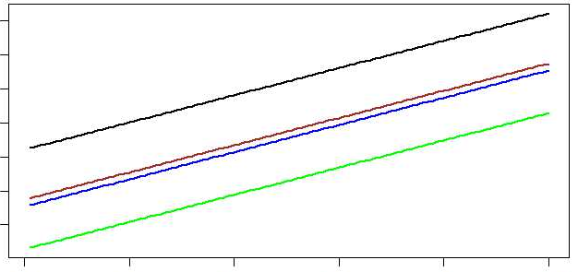
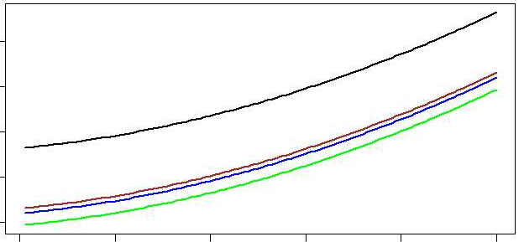
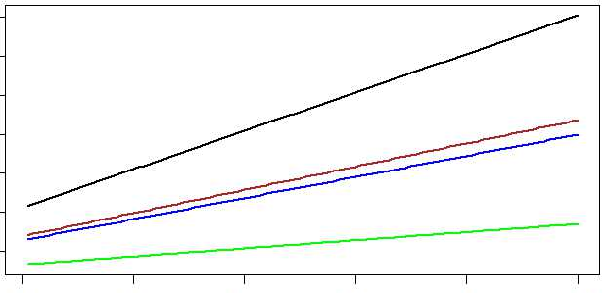
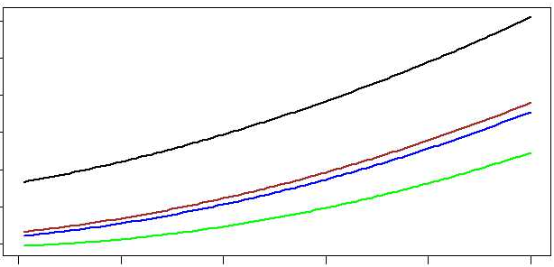
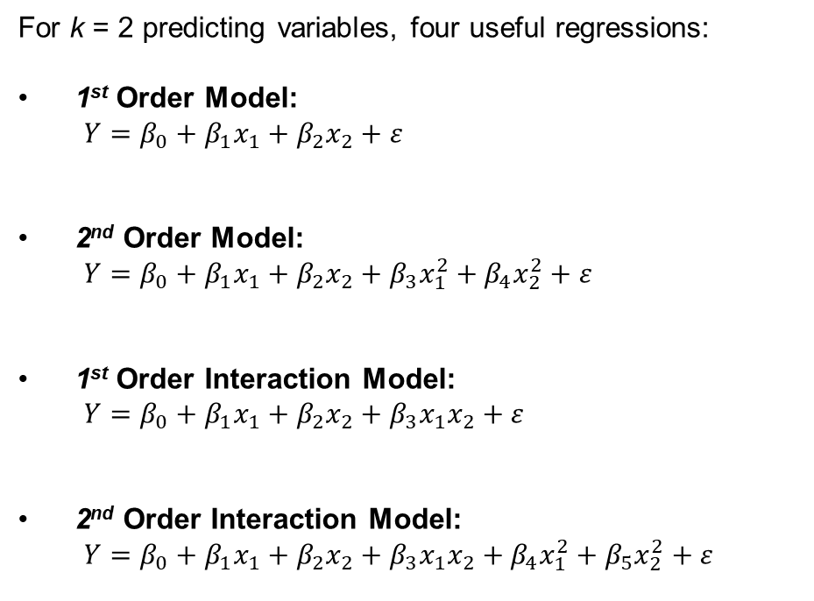
Model Flexibility: Main Effects & Interactions
For k = 2 predicting variables, four useful regressions:
1st Order Model:
$Y=β_{0}+β_{1}x_{1}+β_{2}x_{2}+ε$
2nd Order Model:
$Y=β_{0}+β_{1}x_{1}+β_{2}x_{2}+β_{3}x_{1}^{2}+β_{4}x_{2}^{2}+ε$
1st Order Interaction Model:
$Y=β_{0}+β_{1}x_{1}+β_{2}x_{2}+β_{3}x_{1}x_{2}+ε$
2nd Order Interaction Model:
$Y=β_{0}+β_{1}x_{1}+β_{2}x_{2}+β_{3}x_{1}x_{2}+β_{4}x_{1}^{2}+β_{5}x_{2}^{2}+ε$

Slide 7
Quantitative and Qualitative Variables
Simple Linear Regression: Linear regression with one quantitative predicting variable
ANOVA: Linear regression with one or more qualitative predicting variables
Multiple Linear Regression: Multiple quantitative and qualitative predicting variables

Slide 8
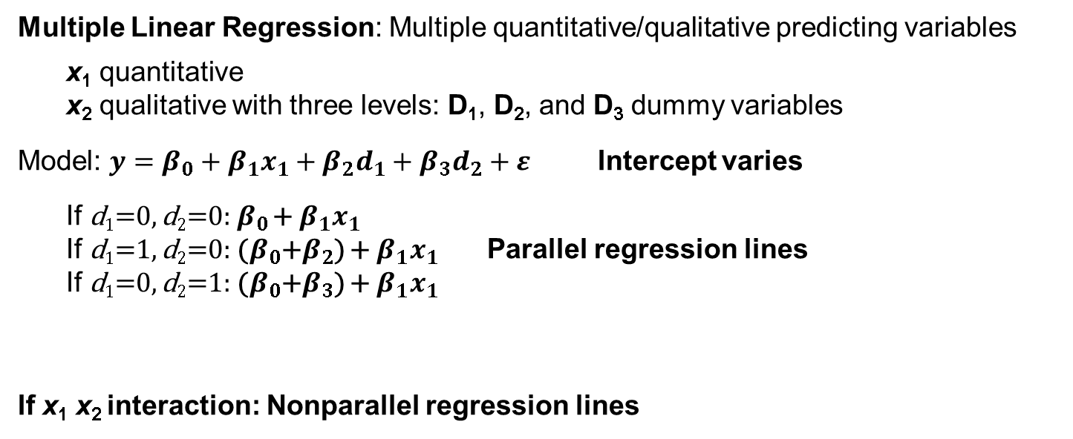
Quantitative and Qualitative Variables
Multiple Linear Regression: Multiple quantitative/qualitative predicting variables
x₁ quantitative
x₂ qualitative with three levels: D₁, D₂, and D₃ dummy variables
Model: $y=β_{0}+β_{1}x_{1}+β_{2}d_{1}+β_{3}d_{2}+ε$ Intercept varies
  If d₁=0, d₂=0: $β_{0}$ + $β_{1}x_{1}$
  If d₁=1, d₂=0: ($β_{0}$+$β_{2}$) + $β_{1}x_{1}$ Parallel regression lines
  If d₁=0, d₂=1: ($β_{0}$+$β_{3}$) + $β_{1}x_{1}$
If x₁ x₂ interaction: Nonparallel regression lines

Slide 9


Linear Regression: Example 1
?
?
Sales
?
Advertisement

Slide 10
Linear Regression: Example 1
Quantitative Predicting Variables:
  X₁ = The amount (in hundreds of dollars) spent on advertising in 1999
  X₂ = The total amount of bonuses paid in 1999
  X₃ = The market share in each territory
  X₄ = The largest competitor's sales
Qualitative Predicting Variable:
  X₅ = Indicates the region of the office (1 = south, 2 = west, 3 = midwest)

Slide 11

Linear Regression: Example 3
Bike sharing systems are of great interest due to their important role in traffic management.
Dataset: Historical data for years 2011-2012 for the bike sharing system in Washington D.C.

Slide 12
Linear Regression: Example 3
Qualitative predicting variables:
X₁ = Day of the week
X₂ = Month of the year
X₃ = Hour of the day (ranging 0-23)
X₄ = Year (2011, 2012)
X₅ = Holiday Indicator
X₆ = Weather condition (with four levels from good weather for level 1 to severe condition for level 4)
Quantitative predicting variables:
X₇ = Normalized temperature
X₈ = Normalized humidity
X₉ = Wind speed

Slide 13
Linear Regression: Example 3
Qualitative predicting variables:
X₁ = Day of the week
X₂ = Month of the year
X₃ = Hour of the day (ranging 0-23)
X₄ = Year (2011, 2012)
X₅ = Holiday Indicator
X₆ = Weather condition (with four levels from good weather for level 1 to severe condition for level 4)
Quantitative predicting variables:
X₇ = Normalized temperature
X₈ = Normalized humidity
X₉ = Wind speed
Year: A quantitative or a qualitative predicting variable?
  If observations are made over many years, then consider it to be quantitative
  If observations are made over only a few years, then consider it to be qualitative

Slide 14

Summary

